Slide 1

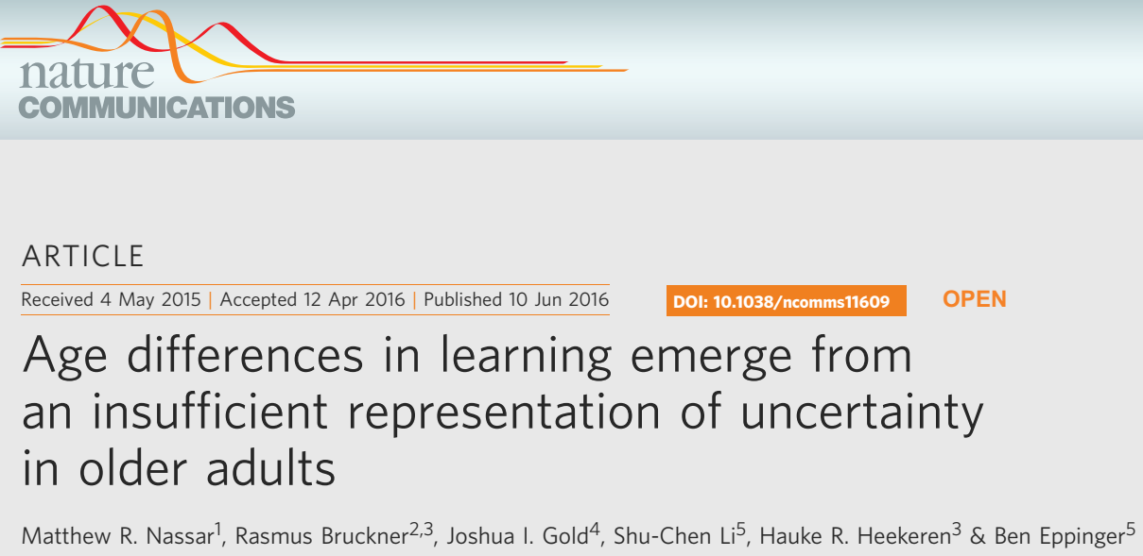
文献分享
Reporter：Chunlei Lu
2022.02.22
Notes:
故事很简单，分析和图 很nice

Slide 2
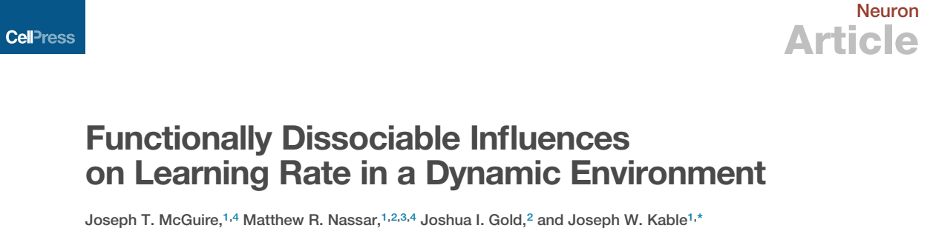
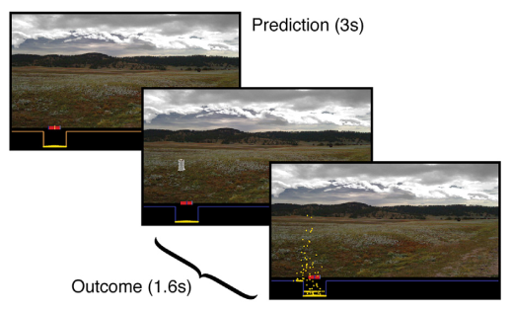
Introduction
2014
- 1 -

Slide 3
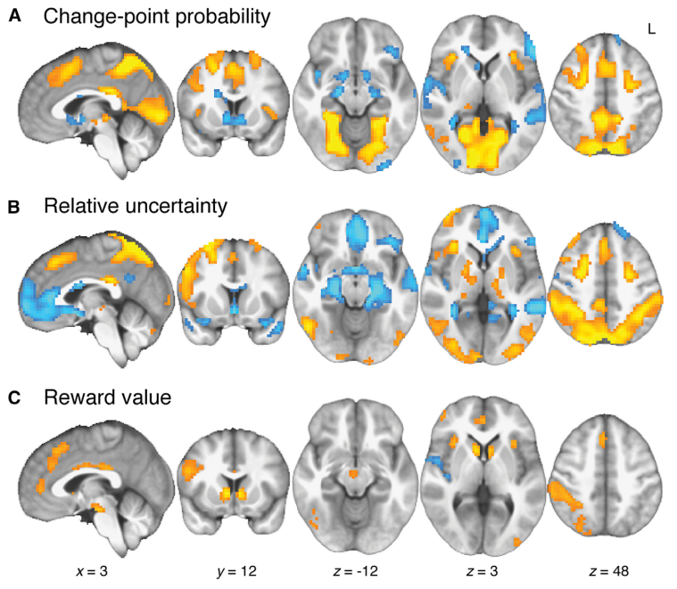
Introduction

Slide 4
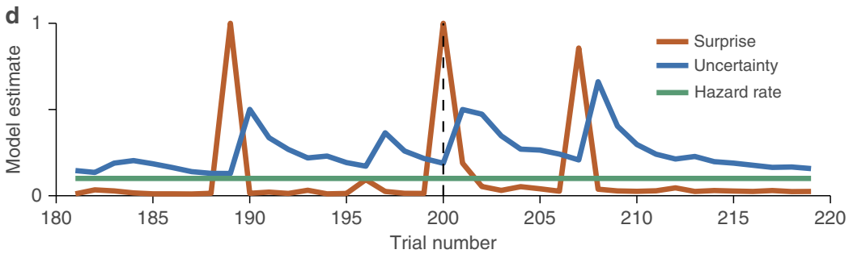
Introduction
Uncertainty
Surprise
Hazard rate
Learning rate
- 1 -

Slide 5
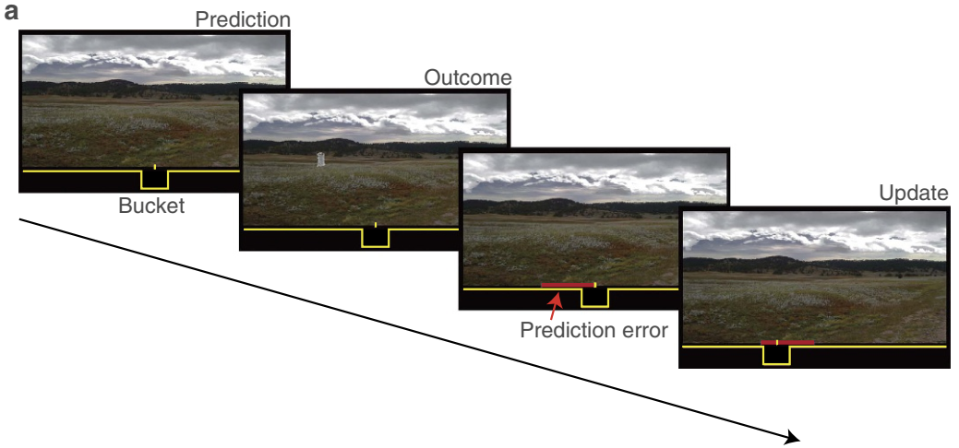
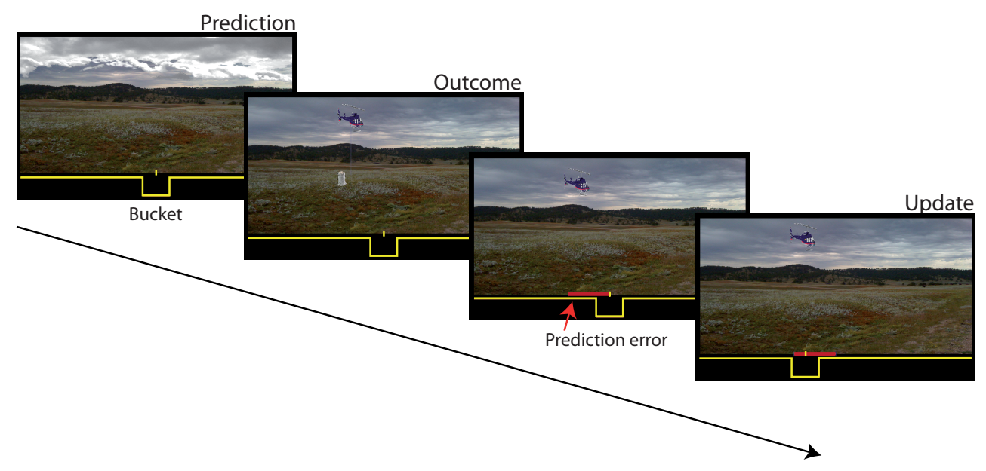
Introduction
- 1 -

Slide 6

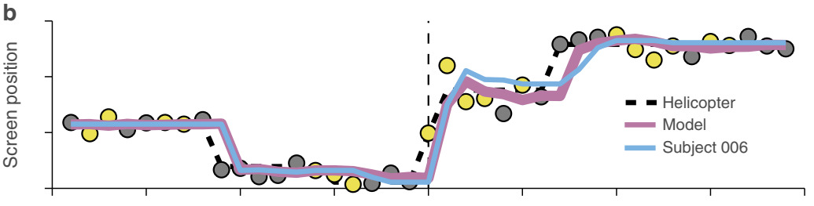
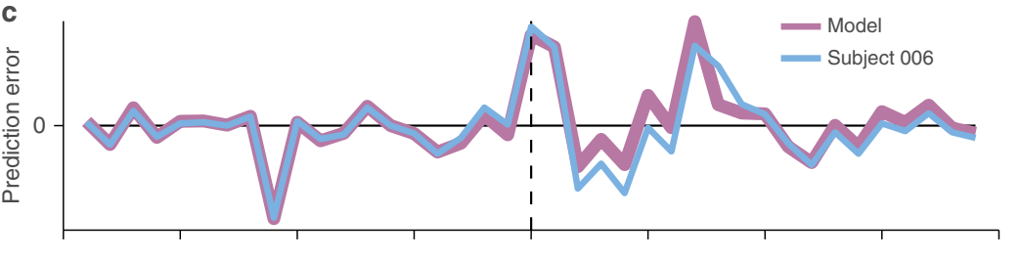

Slide 7
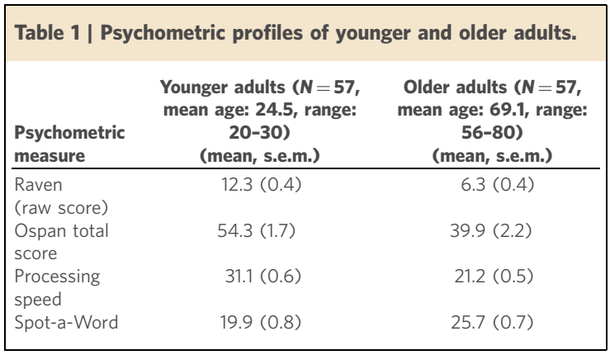
- 1 -
Notes:
que among areas of medicine, psychiatry has no labora tory diagnostic tests. This is largely due to a lack of under standing regarding how mental health symptoms arise from- - dysfunction in underlying brain mechanisms.
计算精神病学被提出
强化学习模型较多被研究和运用

Slide 8
Results
Part 1: Deficits in processing uncertainty, surprise or hazard rate can lead to unique and diagnosable learning deficits
Part 2: Behavioural data: older adults have a deficit in representing and using uncertainty in the service of learning
Part 3: Confirming the finding through quantitative model
- 1 -

Slide 9
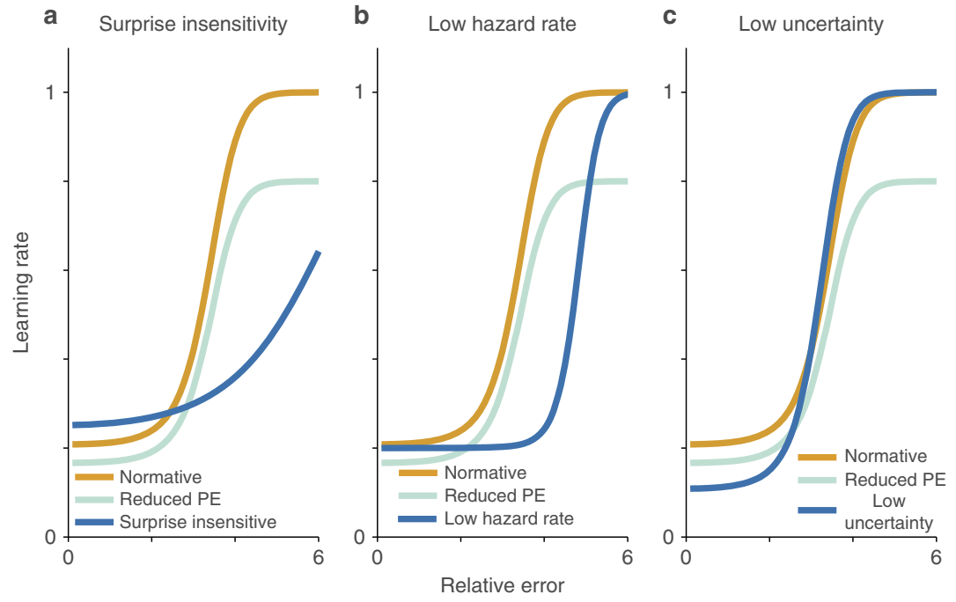
Part 1
Fig. 2 Learning deficits stemming from hypothetical deviations from normative behaviour.
- 1 -

Slide 10
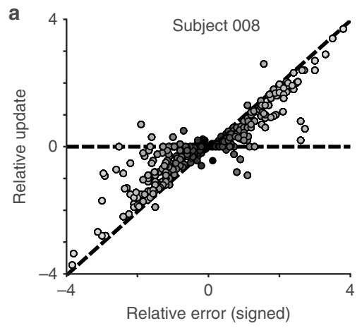
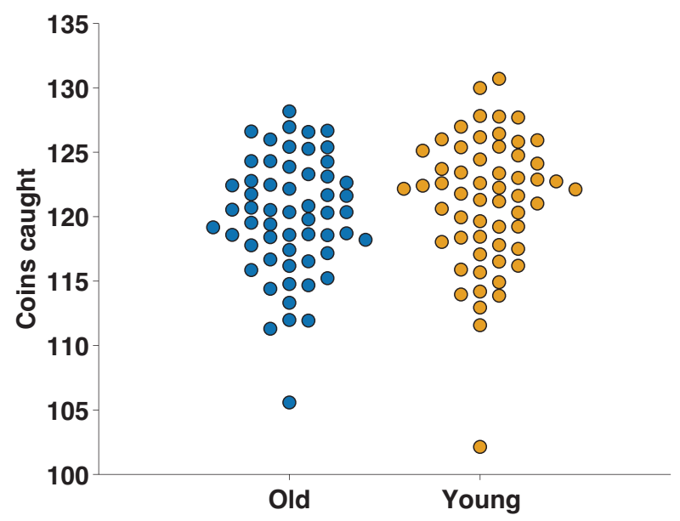
Part 2

Slide 11
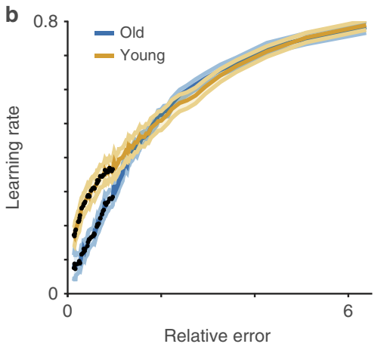
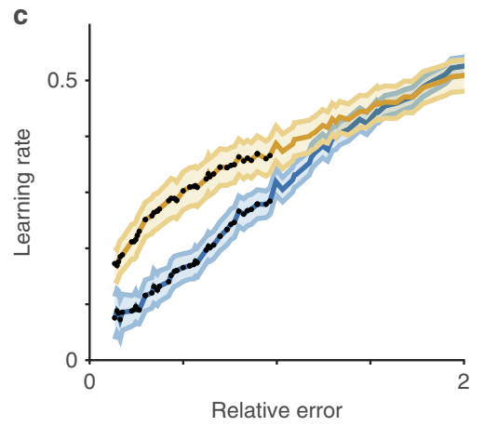
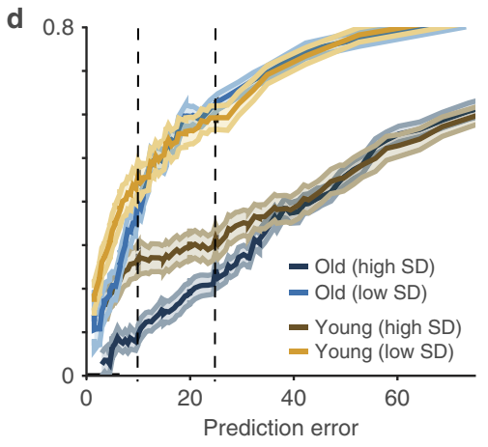
Part 2: Behavioural data
Figure 3 | Younger participants adjusted expectations more after making relatively small errors
- 1 -

Slide 12
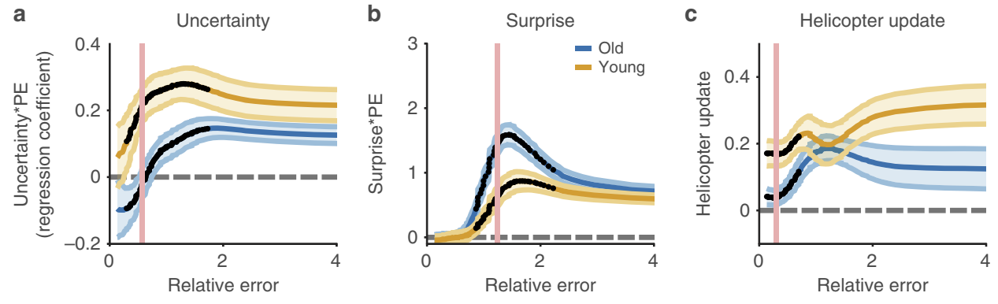
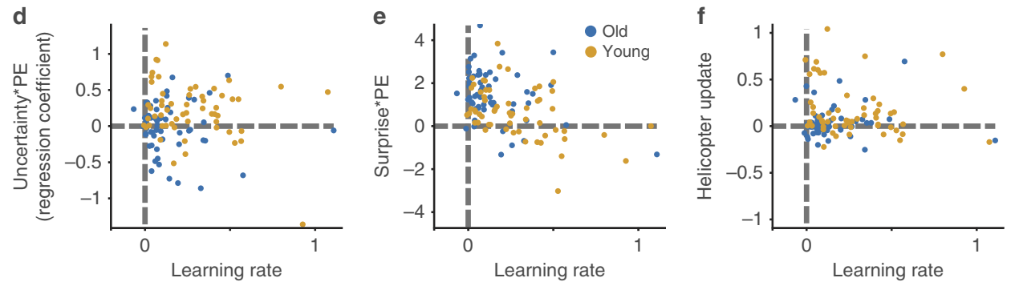
Part 2: Behavioural data
Figure 4 | Age differences in uncertainty and surprise-driven learning.
- 1 -

Slide 13
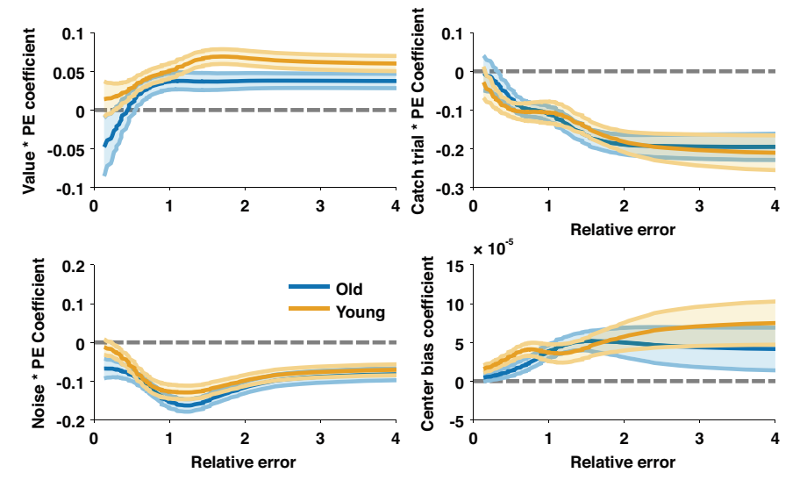
Part 2: Behavioural data
- 1 -

Slide 14
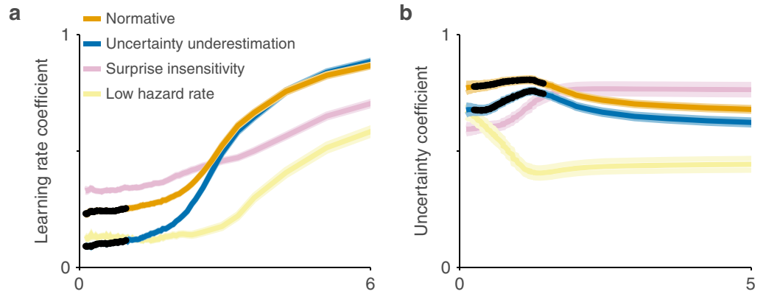
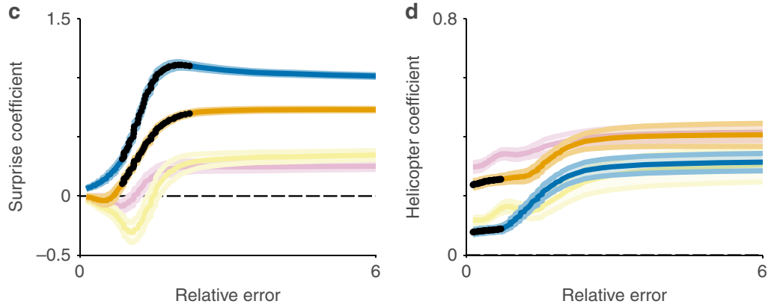
Part 3
Model
Figure 5 | Uncertainty underestimation mimics altered behaviour in older participants.
- 1 -

Slide 15
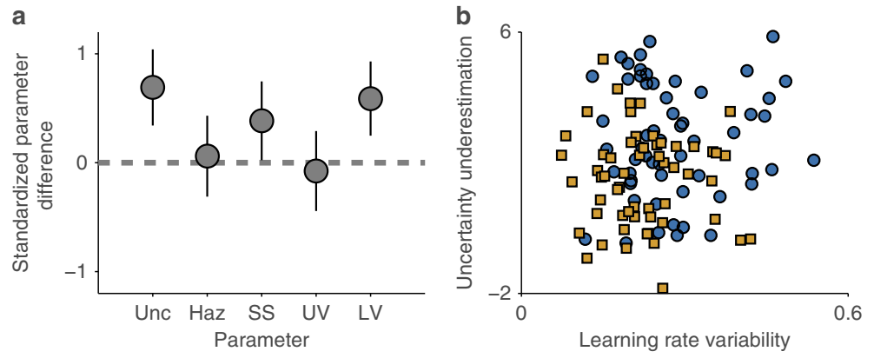
Part 3
Figure 6 | Age-related differences in uncertainty underestimation.
- 1 -

Slide 16
Summary
A normative model：
- uncertainty, surprise and hazard rate
older adults & older adults
- underestimation of uncertainty
- 1 -

